Slide 1

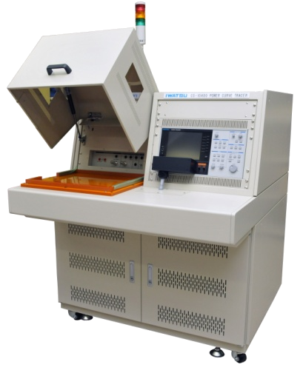
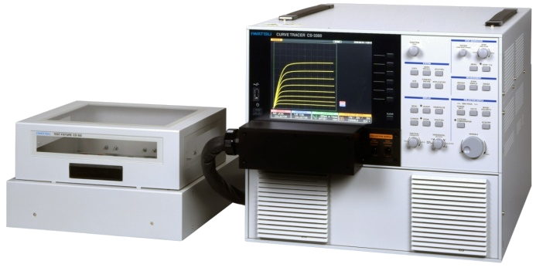
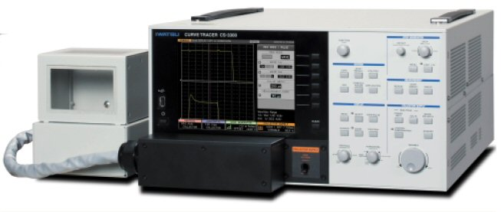
Semiconductor Curve Tracer
Suitable for various semiconductor I-V curve measurement
such as IGBTs, MOS-FETs, Transistors, Diodes, etc.
Curve tracer model: CS-10800
CS-10400
Curve tracer model: CS-5300
CS-5200
CS-3300
CS-3200
Curve tracer model: CS-5100
CS-3100
Iwatsu Test Instruments Corp.
－ Contribute to development of the power electronics – Curve tracer CS series

Slide 2


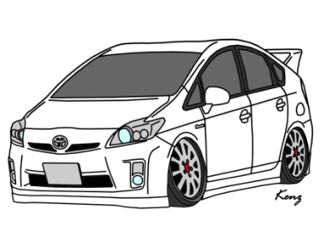
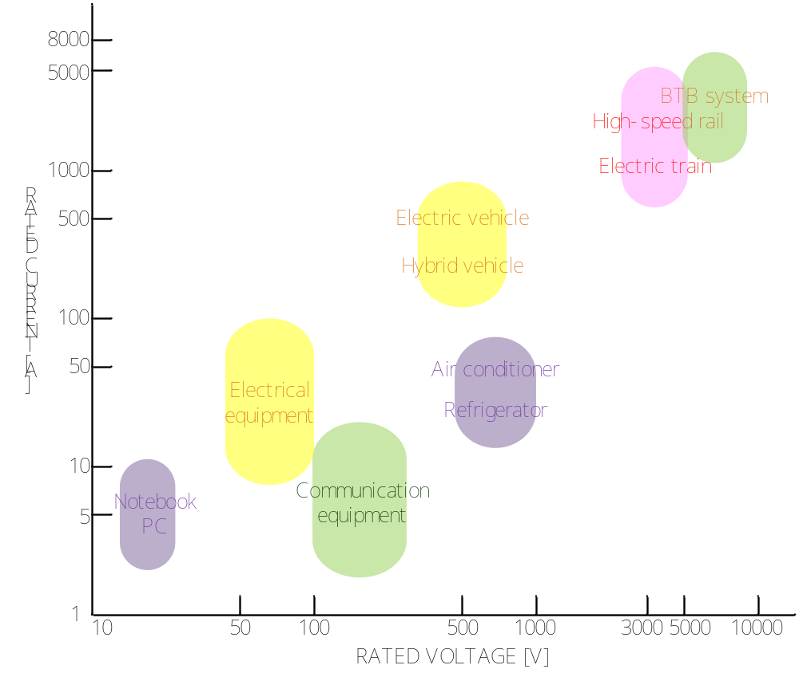
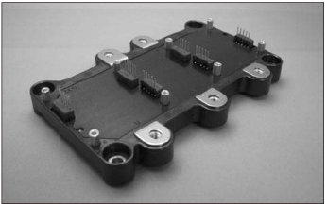
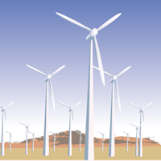

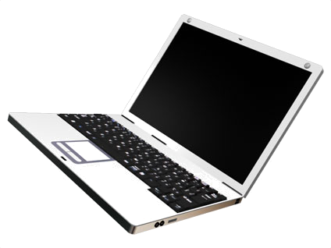
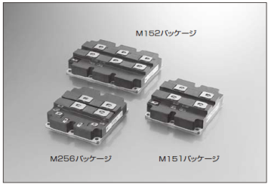
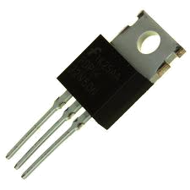

The Device MAP
IPM
IGBT
MOSFET
  Device map : up to 10,000V/8,000A
－ Contribute to development of the power electronics – Curve tracer CS series

Slide 3
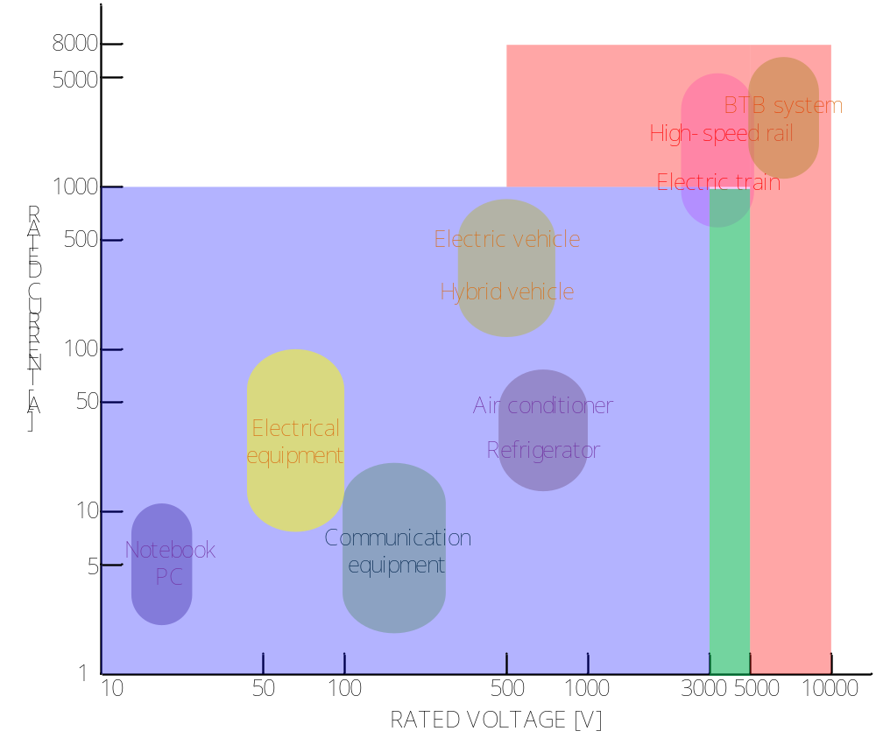

CS series applications on the Device MAP
CS-10000 series （Custom made）
CS-5000 series
（Custom made）
CS-3000 series
  Device map : up to 10,000V/8,000A
－ Contribute to development of the power electronics – Curve tracer CS series

Slide 4
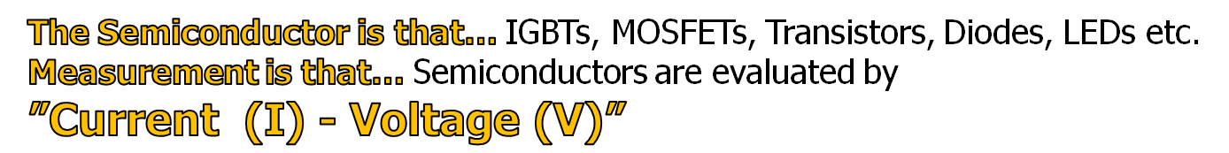
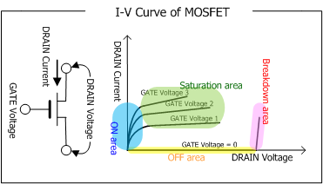
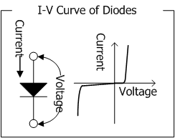
What is measurement item of the curve tracers?
VF
Vdss, Idss
Vce(sat)
VR
RDS(on), Vth
Igss
For example, “Current - Voltage” characteristics of the MOSFET have four kinds of areas, ON area, OFF area, Saturation area and Breakdown area.
Characteristics of these four areas can be observed by the Curve Tracer.
－ Contribute to development of the power electronics – Curve tracer CS series

Slide 5
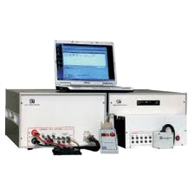
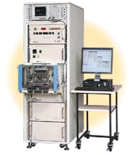

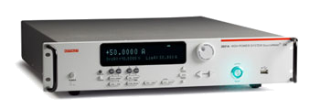
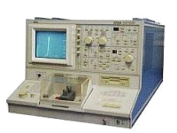
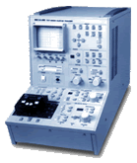
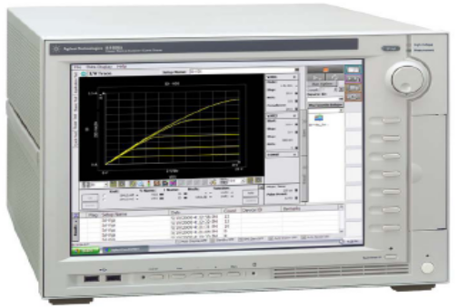
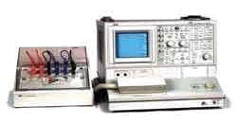
Variation of measuring instruments for device tests
  Testers
  Source meters
  Curve Tracers
Semiconductor parameter analyzers
－ Contribute to development of the power electronics – Curve tracer CS series

Slide 6
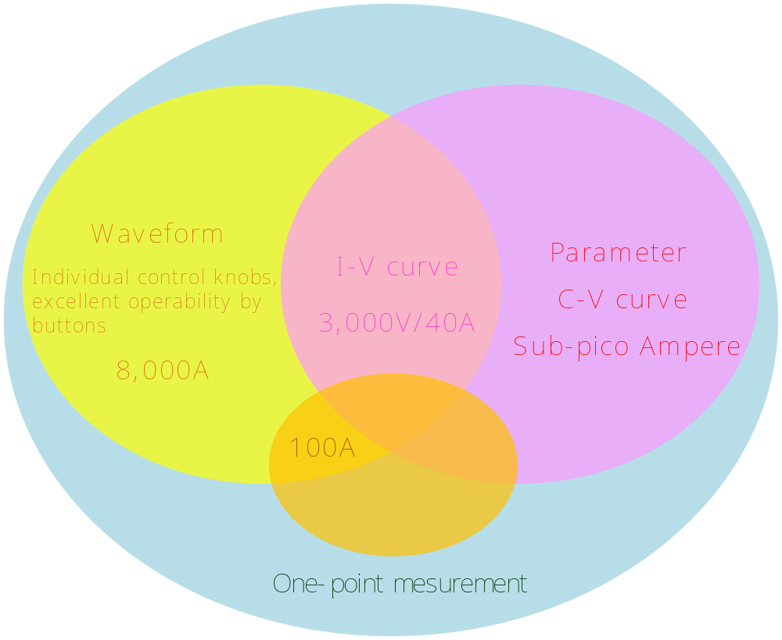
Measurement range of measuring equipments to
be used for semiconductor measurement (1)
Tester
Curve tracer
CS-3000 series
Semiconductor
Parameter analyzer
B1505
Source meter
－ Contribute to development of the power electronics – Curve tracer CS series

Slide 7
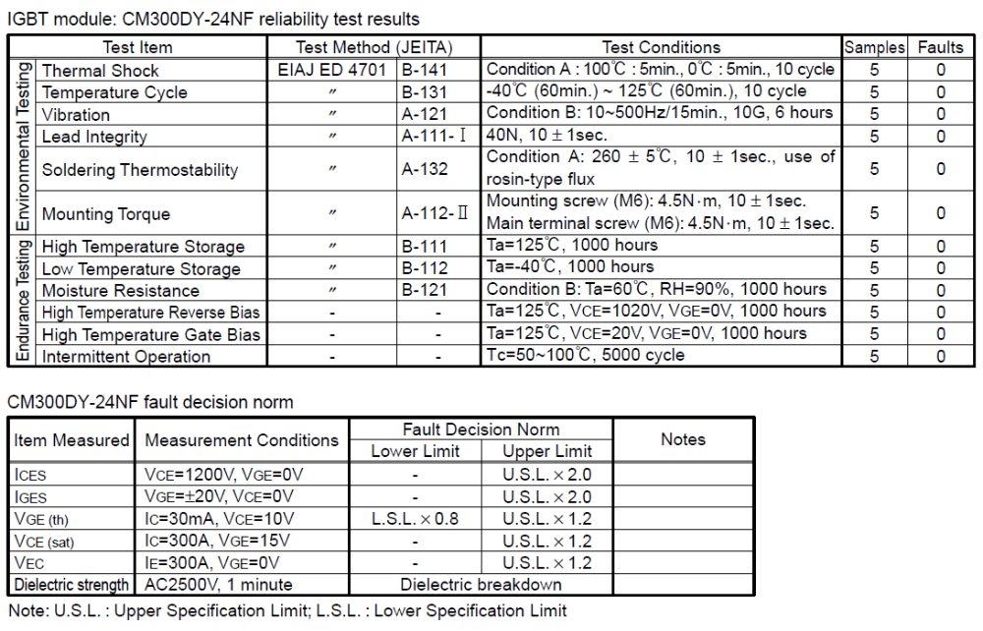
Measurement range of measuring equipments to
be used for semiconductor measurement (2)
- Tester
- Curve tracer
- Parameter analyzer
- Source meter
－ Contribute to development of the power electronics – Curve tracer CS series

Slide 8


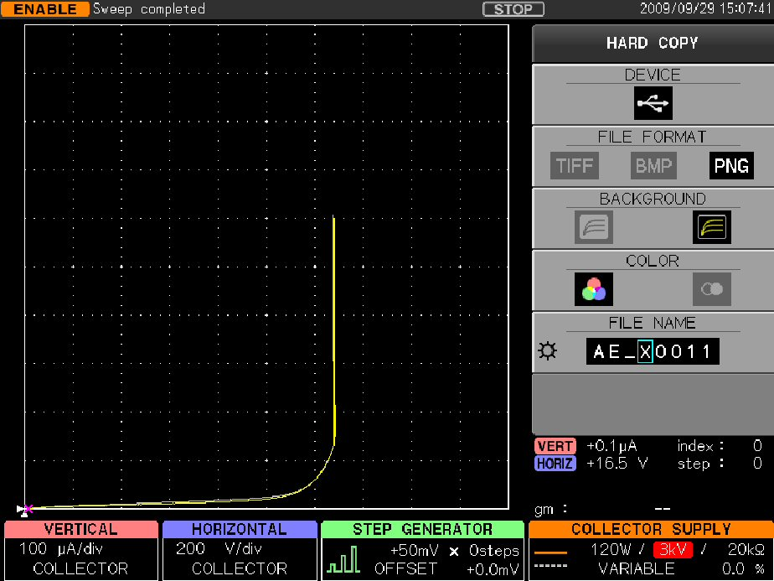

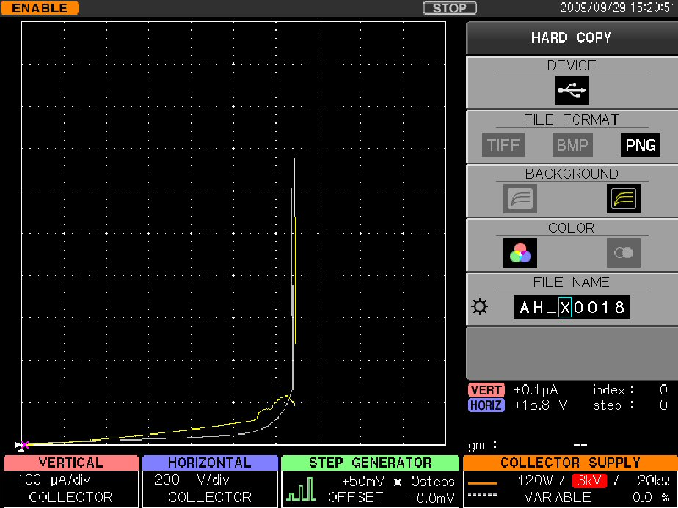
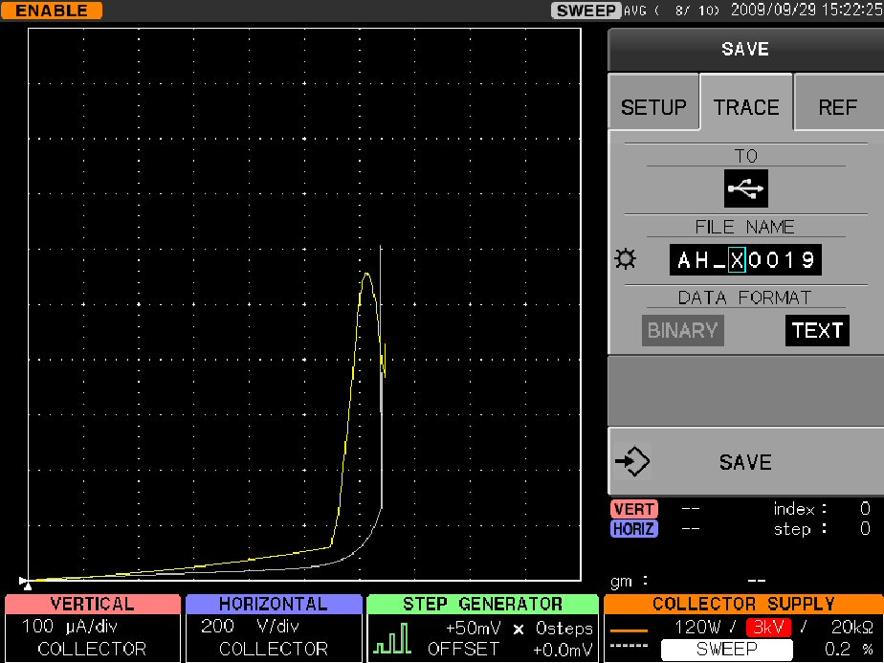

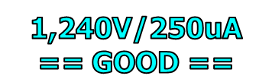

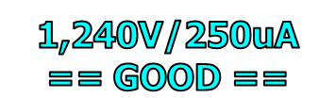
Breakdown Test: evaluation examples
- Curve Tracer vs Tester -
Results of breakdown test of IGBTs (1,200V spec.)
1,200V
1,200V
250μA
1,200V
250μA
250μA
－ Contribute to development of the power electronics – Curve tracer CS series

Slide 9
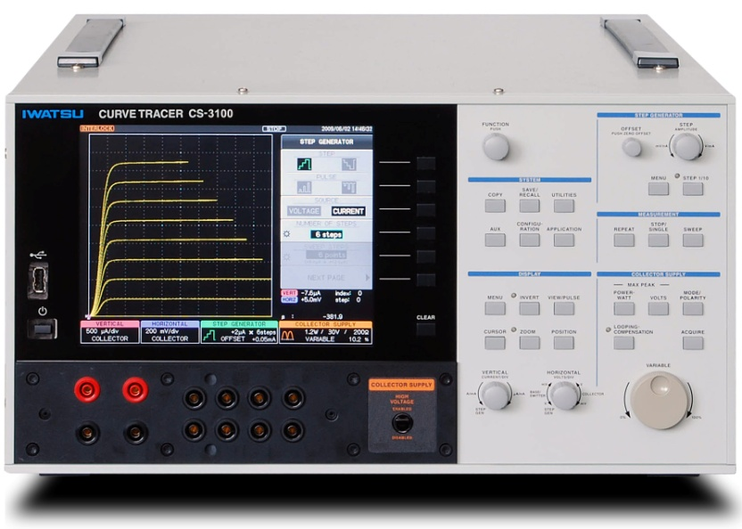
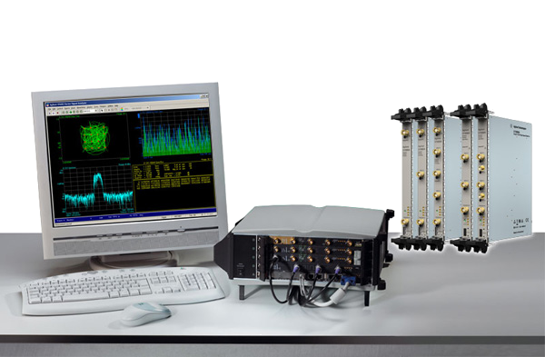
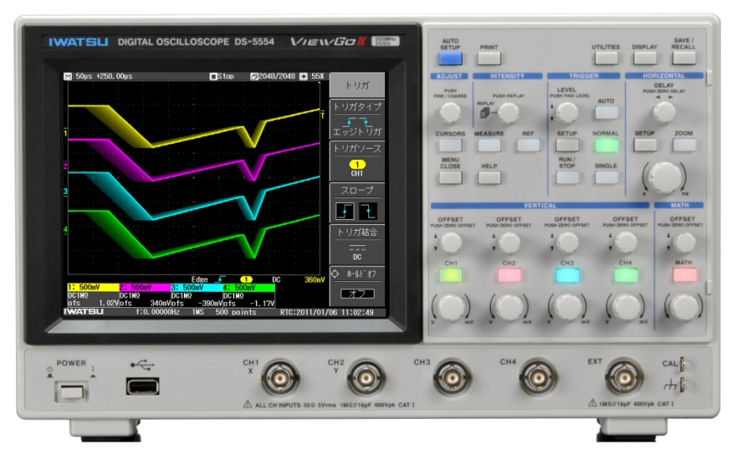
Operability of instruments
  Curve Tracers
  Tester
  Digital oscilloscope
  Digitizer
－ Contribute to development of the power electronics – Curve tracer CS series

Slide 10
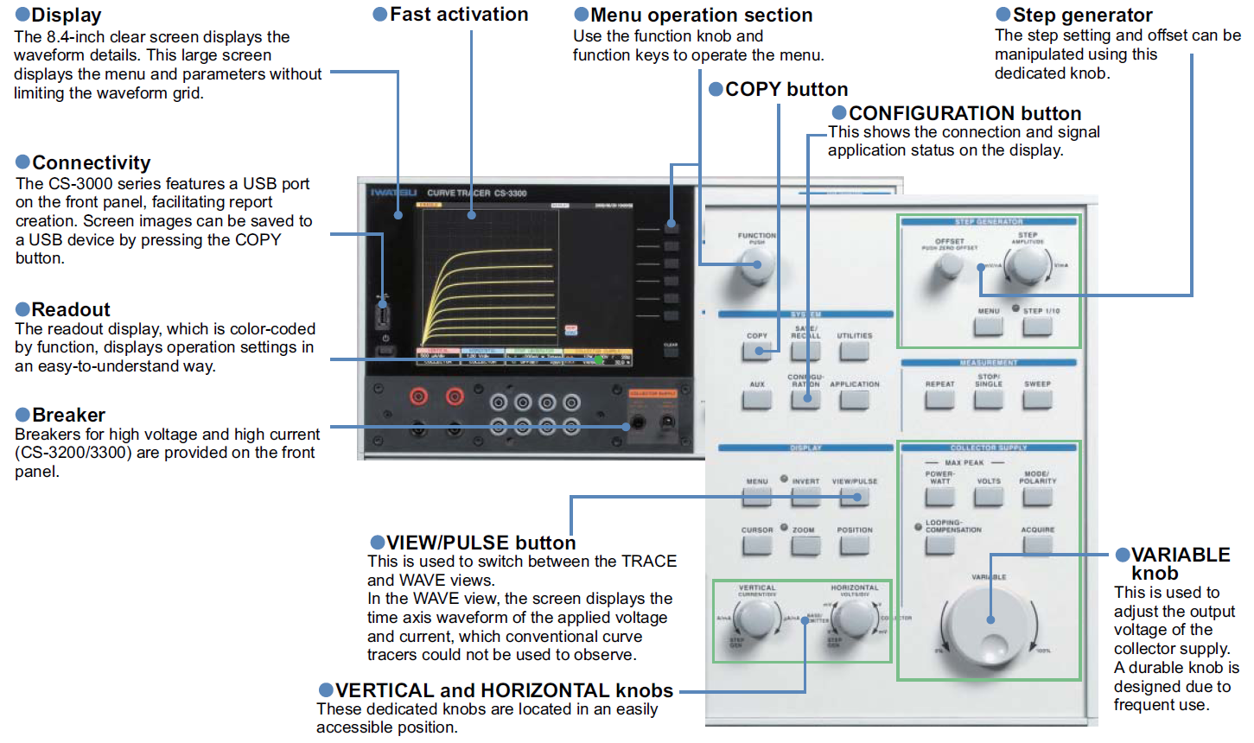

Front panel of the CS series
  Color LCD display & individual control knobs, excellent operability by buttons
－ Contribute to development of the power electronics – Curve tracer CS series

Slide 11

Historical Curve Tracers and IWATSU models (1-2)
  Tektronix Curve Tracers (Discontinued)
  IWATSU Curve Tracers
371A
3000V/40mA, 30V/400A
Option（50V/1000A）
CS-3200: 3000V/75mA, 40V/400A
CS-3300: 3000V/75mA, 40V/1000A
Leakage
mode
370A
2000V/100mA, 16V/20A
CS-3100
3000V/75mA, 30V/15A
－ Contribute to development of the power electronics – Curve tracer CS series

Slide 12
Historical Curve Tracers and IWATSU models (1-2)
 |  | Tektronix |  | IWATSU
Specifications |  | MODEL 371A | MODEL 370A | CS-3300/3200 | CS-3100
High Voltage MODE (1) |  | 3000V/40mA | 2000V/100mA | 3000V/75mA | 3000V/75mA
High Voltage MODE (2) |  | 300V/4mA | 16V/20A | 30V/ 15A | 30V/ 15A
High Current MODE (1) |  | 30V/400A | N/A | 40V/400A | N/A
High Current MODE (2) |  | 50V/1000A | N/A | 40V/1000A | N/A
Collector Supply MODE
 | AC | YES | YES | YES | YES
 | Rectified Sine | YES | YES | YES | YES
 | DC | YES | YES | YES | YES
 | LEAKAGE | N/A | YES | YES | YES
Step Generator
 | Max. step no. | 10-step | 10-step | 20-step | 20-step
 | Pulse width (HV) | 250us Fixed | 80us to 300us | 40us to 400us | 40us to 400us
 | Pulse width (HC) | 500us Fixed | N/A | 40us to 400us | N/A
Max. Data Point |  | 1024 fixed | 1024 fixed | 20 to 1000 | 20 to 1000
Time Axis Waveform |  | N/A | N/A | Vbe/Vce/Ic | Vbe/Vce/Ic
Measurement point |  | Fixed | Fixed | Variable (View PULSE) | Variable (View PULSE)
Display |  | 7.0-inch CRT | 7.0-inch CRT | 8.4-inch color LCD | 8.4-inch color LCD
SWEEP MODE |  | LIMITED | LIMITED | UP/DOWN/COSTOM | UP/DOWN/CUSTOM
Data Storage |  | FDD | FDD | USB/LAN | USB/LAN
－ Contribute to development of the power electronics – Curve tracer CS series

Slide 13
Historical Curve Tracers and IWATSU models (2-1)
  KOKUYO Curve Tracers
  IWATSU Curve Tracers
CS-3100
3000V/75mA, 30V/15A
TCT-2004
2000V/75W, 20V/20A
－ Contribute to development of the power electronics – Curve tracer CS series

Slide 14
Historical Curve Tracers and IWATSU models (2-2)
 |  | KOKUYO (KDK) | IWATSU
Specifications |  | TCT 2004 | CS-3300/3200 | CS-3100
High Voltage MODE (1) |  | 2000V/100mA | 3000V/75mA | 3000V/75mA
High Voltage MODE (2) |  | 20V/20A | 30V/ 15A | 30V/ 15A
High Current MODE (1) |  | N/A | 40V/400A | N/A
High Current MODE (2) |  | N/A | 40V/1000A | N/A
Collector Supply MODE
 | AC | YES | YES | YES
 | Rectified Sine | YES | YES | YES
 | DC | YES | YES | YES
 | LEAKAGE | N/A | YES | YES
Step Generator
 | Max. step no. | 10-step | 20-step | 20-step
 | Pulse width (HV) | 80us to 300us | 40us to 400us | 40us to 400us
 | Pulse width (HC) | N/A | 40us to 400us | N/A
Max. Data Point |  | 1024 fixed | 20 to 1000 | 20 to 1000
Time Axis Waveform |  | N/A | Vbe/Vce/Ic | Vbe/Vce/Ic
Measurement point |  | Fixed | Variable (View PULSE) | Variable (View PULSE)
Display |  | 6.0-inch CRT | 8.4-inch color LCD | 8.4-inch color LCD
SWEEP MODE |  | LIMITED | UP/DOWN/COSTOM | UP/DOWN/CUSTOM
Data Storage |  | FDD | USB/LAN | USB/LAN

Slide 15
FEATURES of CS-3000/5000/10000 series curve tracers
■ CS-10800/CS-10400/CS-5300/CS-5200/CS-5100/
CS-3300 / CS-3200 / CS-3100 eight models line-up
■ Max. peak voltage at 10,000V (CS-10000 series)
Max. peak voltage at 5,000V (CS-5000 series)
Max. peak voltage at 3,000V (CS-3000 series)
■ Max. peak current at 8,000A(CS-10800)
Max. peak current at 4,000A(CS-10400)
Max. peak current at 1,000A(CS-5300, CS-3300)
Max. peak current at 400A(CS-5200, CS-3200)
■ 4 kinds of Collector supply MODE for High Voltage mode
AC, Rectified Sine, DC, Leakage (with 1pA cursor resolution)
■ USB I/F for saving display image, waveform data (CSV)
and measurement setup
■ LAN I/F for remote control
－ Contribute to development of the power electronics – Curve tracer CS series

Slide 16
General specifications of CS-3000 series
MODEL |  | CS-3100 |  |  | CS-3200 |  |  |  |  |  |  |  |  | CS-3300
Collector supply MODE
High Voltage Mode (HV mode)
 | Waveform | AC, +/- Rectified Sine, +/-DC, +/-LEAKAGE
 | Measurement Range
 |  |  | Maximum peak current |  |  |  |  |  | Max. peak voltage
 |  |  | （Max. peak pulse current）
 |  |  | 75mA (150mA) |  |  |  |  |  | 3,000V
 |  |  | 750mA (1.5A) |  |  |  |  |  | 300V
 |  |  | 7.5A (15A) |  |  |  |  |  | 30V
High Current Mode (HC mode)
 | Waveform |  |  |  | +/- PULSE
 | Measurement Range
 |  |  |  |  |  | Max. peak current |  | Max. peak voltage |  |  |  |  |  | Max. peak current |  | Max. peak voltage
 |  |  |  |  |  | 400A |  | 40V |  |  |  |  |  | 1,000A |  | 40V
 |  |  |  |  |  | 40A |  | 40V |  |  |  |  |  | 400A |  | 40V
 |  |  |  |  |  |  |  |  |  |  |  |  |  | 40A |  | 40V
－ Contribute to development of the power electronics – Curve tracer CS series

Slide 17
General specifications of CS-5000 series
MODEL |  | CS-5100 |  |  | CS-5200 |  |  |  |  |  |  |  |  | CS-5300
Collector supply MODE
High Voltage Mode (HV mode)
 | Waveform | AC, +/- Rectified Sine, +/-DC, +/-LEAKAGE
 | Measurement Range
 |  |  | Maximum peak current |  |  |  |  |  | Max. peak voltage
 |  |  | （Max. peak pulse current）
 |  |  | 25mA (25mA) |  |  |  |  |  | 5,000V
 |  |  | 750mA (1.5A) |  |  |  |  |  | 300V
 |  |  | 7.5A (15A) |  |  |  |  |  | 30V
High Current Mode (HC mode)
 | Waveform |  |  |  | +/- PULSE
 | Measurement Range
 |  |  |  |  |  | Max. peak current |  | Max. peak voltage |  |  |  |  |  | Max. peak current |  | Max. peak voltage
 |  |  |  |  |  | 400A |  | 40V |  |  |  |  |  | 1,000A |  | 40V
 |  |  |  |  |  | 40A |  | 40V |  |  |  |  |  | 400A |  | 40V
 |  |  |  |  |  |  |  |  |  |  |  |  |  | 40A |  | 40V
－ Contribute to development of the power electronics – Curve tracer CS series

Slide 18
General specifications of CS-10000 series
MODEL |  | CS-10400 |  |  |  |  |  |  |  |  | CS-10800
Collector supply MODE
High Voltage Mode (HV mode)
 | Waveform | AC, +/- Rectified Sine, +/-DC, +/-LEAKAGE
 | Measurement
 | Range |  |  | Maximum peak current |  |  |  |  |  |  | Max. peak voltage
 |  |  |  | （Max. peak pulse current）
 |  |  |  | 400mA (+DC only) |  |  |  |  |  |  | 10,000V
 |  |  |  | 75mA (150mA) |  |  |  |  |  |  | 3,000V
 |  |  |  | 750mA (1.5A) |  |  |  |  |  |  | 300V
 |  |  |  | 7.5A (15A) |  |  |  |  |  |  | 30V
High Current Mode (HC mode)
 | Waveform | +/- PULSE
 | Measurement
 | Range |  | Max. peak current |  |  |  | Max. peak voltage |  |  |  |  | Max. peak current |  |  | Max. peak voltage
 |  |  | 4,000A |  |  |  | 60V |  |  |  |  | 8,000A |  |  | 60V
 |  |  | 4000 |  |  |  | 60V |  |  |  |  | 4,000A |  |  | 60V
 |  |  | 40A |  |  |  | 60V |  |  |  |  | 4000 |  |  | 60V
 |  |  |  |  |  |  |  |  |  |  |  | 400 |  |  | 60V
－ Contribute to development of the power electronics – Curve tracer CS series

Slide 19

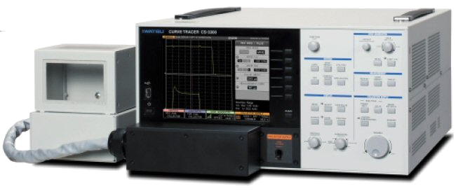
Semiconductor Curve Tracer
CS-3000 series
Suitable for various semiconductor I-V curve measurement
such as IGBTs, MOS-FETs, Transistors, Diodes, etc.
Curve tracer model: CS-3300 & CS-3200
Curve tracer model: CS-3100
Iwatsu Test Instruments Corp.
－ Contribute to development of the power electronics – Curve tracer CS series

Slide 20
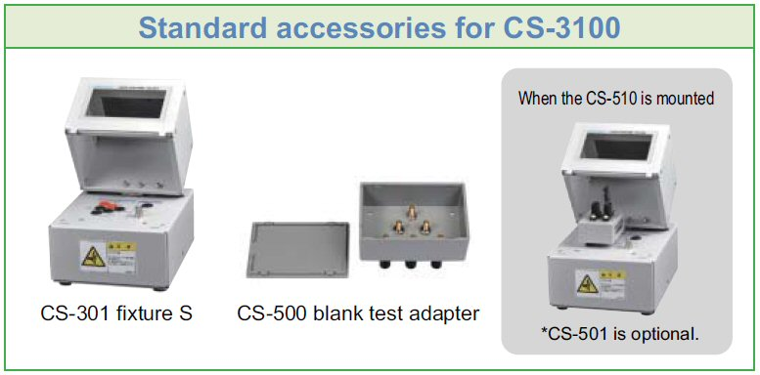
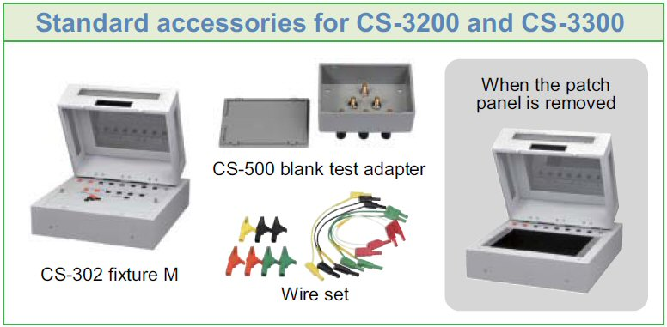
CS-3100 Curve Tracer
  Configuration of CS-3100
CS-3100 Main unit
Fixture-S
Option accessories for CS-3100
－ Contribute to development of the power electronics – Curve tracer CS series

Slide 21
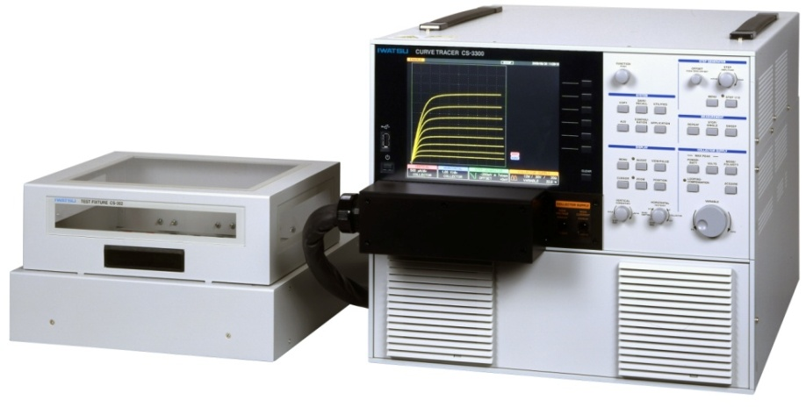
CS-3300 & CS-3200 Curve Tracer
  Configuration of CS-3300/3200
CS-3300/3200 Main unit
Fixture-M
－ Contribute to development of the power electronics – Curve tracer CS series

Slide 22
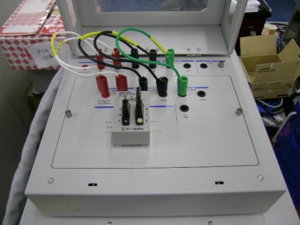
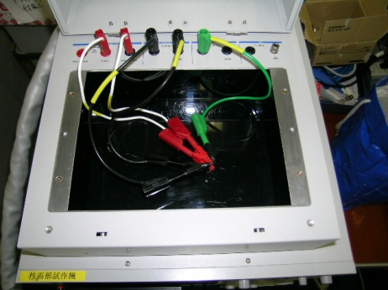
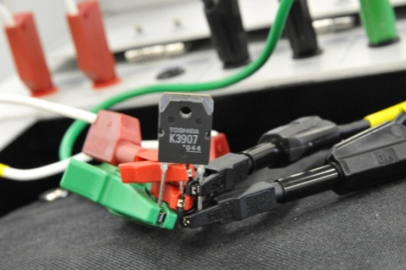
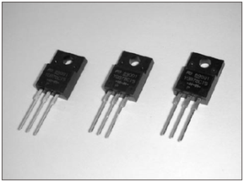
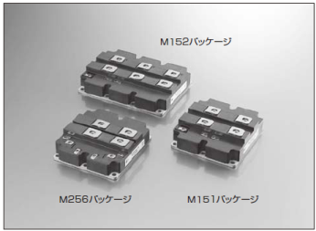

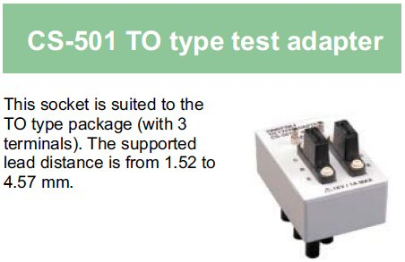
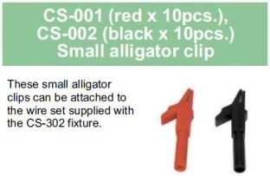
Measurement examples - Package Products -
  High Voltage MODE (HV)
  High Current MODE (HC)
  Cables + Patch panel
  + TO Type Test adaptor (Option)
  Cables + Small Alligator Clips (option)
Power MOSFET
IGBT
IPM
Option
Power MOSFET
Option
－ Contribute to development of the power electronics – Curve tracer CS series

Slide 23
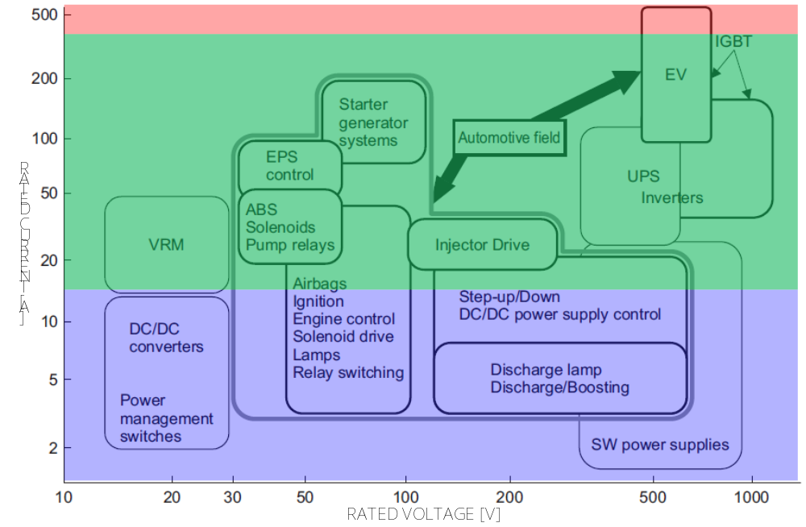
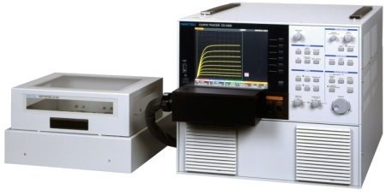
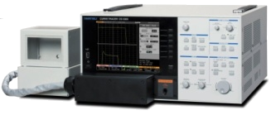
CS-3000 applications on the Device MAP
Curve Tracer
CS-3200
/CS-3300
Curve Tracer
CS-3100
  Device map : up to 1,000V/500A
－ Contribute to development of the power electronics – Curve tracer CS series

Slide 24
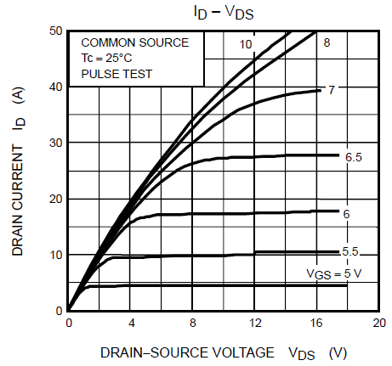
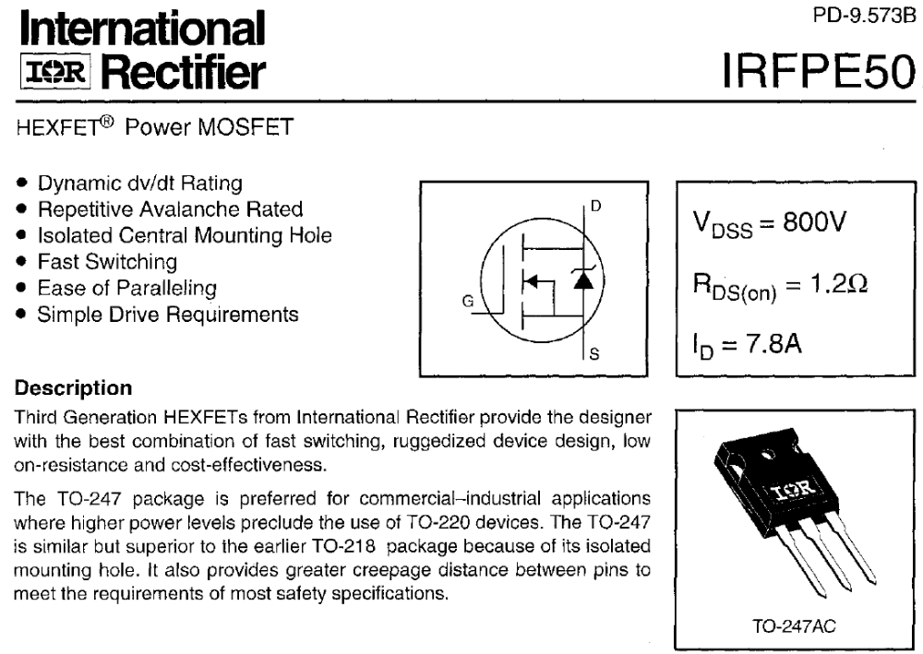
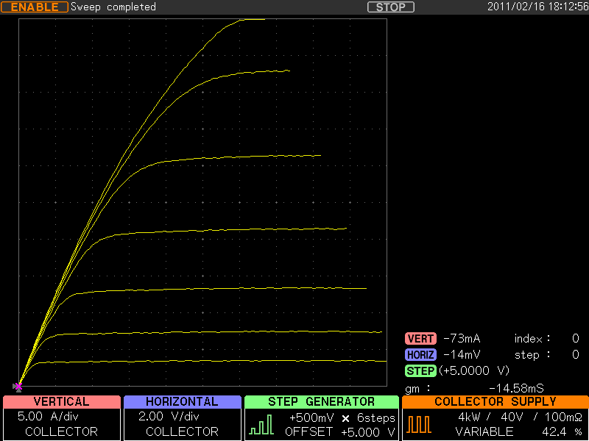
What is measurement item of the curve tracers? (2)
■ Evaluation of I-V characteristics
■ Comparison with catalog and actual performance
－ Contribute to development of the power electronics – Curve tracer CS series

Slide 25
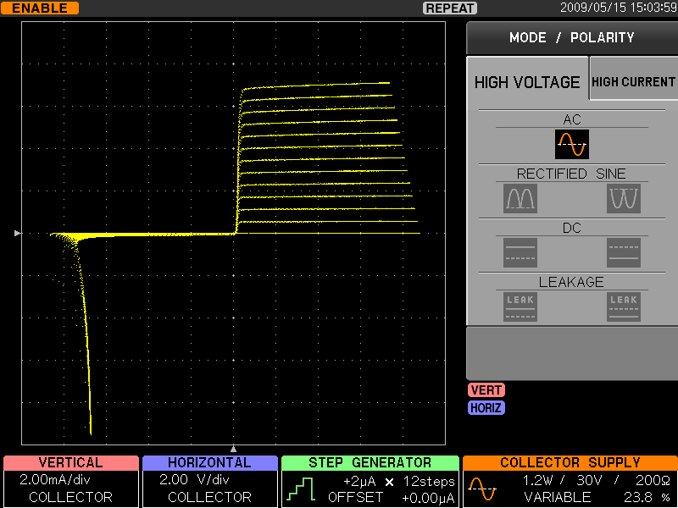



Main features of CS-3000 series (1)
■ 4 Collector supply modes: AC, +/- Rectified Sine, +/-DC, +/-LEAKAGE
AC
＋Rectified Sine
+DC
+LEAKAGE
－ Contribute to development of the power electronics – Curve tracer CS series

Slide 26


Main features of CS-3000 series (2)
  ■ Max. 20-step measurement
Step Generator:
Available to set 0 to 20step for more efficient measurements
－ Contribute to development of the power electronics – Curve tracer CS series

Slide 27


Main features of CS-3000 series (3)
  ■ Sweep functions
Sweep at 1,000points
Sweep at 50points (less visible)
Maximum display points setting
from 20points up to 1,000points
for more efficient measurements
－ Contribute to development of the power electronics – Curve tracer CS series

Slide 28



Unique functions of CS-3000 series (1)
■ Graphical configuration block diagram for the measurement system
  Conf. 1 for I-V Curve measurement
  Conf. 3 for BREAK DOWN measurement
－ Contribute to development of the power electronics – Curve tracer CS series

Slide 29


Unique functions of CS-3000 series (2)
■ Two of viewing modes: TRACE & WAVE
  TRACE mode (I-V Curve display)
  WAVE mode (Vbe, Vce, Ic)
－ Contribute to development of the power electronics – Curve tracer CS series

Slide 30



Unique functions of CS-3000 series (3)
■ Variable setting conditions：
Large current mode:
1. Output pulse: variable from 50μs to 400μs
2. Measurement points: 20points to 1,000points
3. Repetitive cycle: variable from 80ms to 1,000ms
－ Contribute to development of the power electronics – Curve tracer CS series

Slide 31


Built-in option program of CS-3000 series
■ CS-800 Semiconductor Parameter search (option)
  LIMIT SWEEP
  Vth/hFE SETUP
Semi-Automatic SWEEP measurement can be performed after set the Vertical and Horizontal limit
Semi-Automatic Vth, hFE
measurement can be performed after set the parameters
Example of MOSFET breakdown voltage
measurement
Example of MOSFET Vth measurement
－ Contribute to development of the power electronics – Curve tracer CS series

Slide 32


Software options of CS-3000 series
■ CS-810 Semiconductor Parameter measurement (option)
■Reference level setting
level 1: <1uA
level 2: <10uA
level 3: <20uA
－ Contribute to development of the power electronics – Curve tracer CS series

Slide 33
Reference waveform of CS-3000 series
<< Display example >>
Yellow-colored line = Current waveform
Gray-colored lien = Reference waveform
－ Contribute to development of the power electronics – Curve tracer CS series

Slide 34
USB interface of CS-3000 series
Data image of
“CSV” format.
“CSV” =
comma separated value
Measurement results can be saved to USB device as CSV format.
Configuration = BSGEN
HCHV_Unit = HC
Collect_Mode = +HC
Variable = 21.6% ~ 0.0%
Stepgen_Mode = PULSE
Stepgen_Range = +2V
Stepgen_Offset = +4.00 V
Vbe_AcqRange = 5.00 V / div
Vce_AcqRange = 1.00 V / div
Ice_AcqRange = 10.0 A / div
Sweep_Mode = COLLECTOR
step | index | Vbe | Vce | Ic
0 | 0 | 4.003 | -0.021 | 0.53
0 | 1 | 4.007 | 0.525 | -0.17
0 | 2 | 4.007 | 1.069 | -0.58
0 | 3 | 4.003 | 1.602 | 0.25
0 | 4 | 4.01 | 2.095 | -0.57
0 | 5 | 4.014 | 2.547 | -0.17
0 | 6 | 4.007 | 2.797 | 0.3
0 | 7 | 4.003 | 3.145 | 0.1
0 | 8 | 4.007 | 3.59 | -0.71
0 | 9 | 4.01 | 4.129 | -0.6
0 | 10 | 4.007 | 4.381 | 0.69
0 | 11 | 4.007 | 4.734 | -0.18
0 | 12 | 4.007 | 5.167 | -0.82
0 | 13 | 4.007 | 5.802 | -0.03
0 | 14 | 4.007 | 6.188 | -0.32
0 | 15 | 4.007 | 6.697 | 0.06
0 | 16 | 4.007 | 7.228 | 0.16
0 | 17 | 4.007 | 7.754 | -0.4
0 | 18 | 4.01 | 8.283 | -0.5
0 | 19 | 4.007 | 8.774 | -0.32
0 | 20 | 4.003 | 9.999 | -0.53
1 | 0 | 6.003 | -0.018 | -0.65
1 | 1 | 6.003 | 0.523 | 0
1 | 2 | 6 | 1.01 | 0.63
1 | 3 | 6 | 1.55 | 0.16
－ Contribute to development of the power electronics – Curve tracer CS series

Slide 35



Remote control tool free ware (via LAN I/F)
CS-3000 Curve tracers are capable to output results and settings into USB port on front panel. Also a copy of the screen, measurement results in the CSV format, and other data can be directly transferred to the PC via LAN I/F.
  CSV
  COPY
  SETUP
  COMMAND
－ Contribute to development of the power electronics – Curve tracer CS series

Slide 36




Curve tracer I/F option
  CS Fix connector box
  CS to Prober Cable (Custom made)
  CS side connector
  Prober side connector
－ Contribute to development of the power electronics – Curve tracer CS series

Slide 37

Curve tracer applications： Fixture with a HOT PLATE
= room temperature to 200-digree =
－ Contribute to development of the power electronics – Curve tracer CS series

Slide 38
CS series applications on the Device MAP
CS-10000 series （Custom made）
CS-5000 series
（Custom made）
CS-3000 series
  Device map : up to 10,000V/8,000A
－ Contribute to development of the power electronics – Curve tracer CS series

Slide 39
Thank you for your interests!
－ Contribute to development of the power electronics – Curve tracer CS series

Slide 40
－ Contribute to development of the power electronics – Curve tracer CS series

